Slide 1


EU4Belarus SALT III - Support for Advanced Learning and Training
Academic Research Project Grants
Pre-recorded informational video for applicants
eu4belarus.info

Slide 2

Contents
What is EU4 Belarus and SALT III?
Guidelines for applicants of the call for proposals.
  Who can apply and for what activities?
    1.1. Objectives
    1.2. Financial allocation
    1.3. Eligibility criteria
  How to apply?
    2.1. Online application form.
    2.2. Budget (Annex B)
    2.3. Logframe (Annex C)
    2.4. Supporting documents
Evaluation process
Timeline of the call for proposals
Questions and answers
eu4belarus.info

Slide 3

I. What is EU4Belarus
and
SALT III?
eu4belarus.info

Slide 4

EU4Belarus and SALT III
EU4Belarus: Reinforcing Resilience and Democratisation is the European Union financed Programme/special measure adopted by the European Commission in December 2021 with the overall objective to reinforce the resilience and capacity among the Belarusian people affected by the political crisis to achieve democratic changes in Belarus.
As part of this special measure, EU4BELARUS: Support for Advanced Learning and Training (hereinafter – SALT III) concerns the implementation of one of the special measure’s components targeting education sector.
SALT III programme is specifically designed to establish support schemes for Belarusian students, lecturers, scientists, and young professionals who have faced repression and persecution.
eu4belarus.info

Slide 5
What is the Academic Research Grants Scheme for?
In the framework of SALT III programme, a support scheme has been foreseen to provide a support to Belarusian university professors and researchers to undertake collective research projects and participate in international research programmes.
The scheme is intended to enable Belarusian academic staff to consolidate and preserve the Belarusian academic community and its integration in the common European educational space by promoting international cooperation.
The support scheme is administered by Central Project Management Agency (CPVA) (based in Vilnius, Lithuania), who acts as a contracting authority, and in close collaboration with the independent Belarusian civil society organisations.
The call for proposals is open from 17/12/2024 to 17/03/2025 at CPVA website https://cpva.lt/en/calls-for-proposals and EU4Belarus website https://eu4belarus.info/
eu4belarus.info

Slide 6
II. Guidelines for applicants of the call for proposals
eu4belarus.info

Slide 7

1.1. Objectives
eu4belarus.info

Slide 8
1.1. What are the objectives of the scheme?
The global objective of this call for proposals is to support Belarusian academic staff to support their joint projects with academic staff from EU-based higher education institutions and/or Belarusians who have not left the country.
The specific objective of this call for proposals is to provide opportunities for consolidating and preserving the Belarusian academic community and its integration in the common European educational space by promoting international cooperation through academic research project grants.
eu4belarus.info

Slide 9
1.2. Financial allocation
eu4belarus.info

Slide 10
1.2. What is the financial allocation of the scheme? (1)
The overall indicative amount of the call for proposals: EUR 965.000
The grant scheme is structured in 2 lots:
Lot 1. Academic research projects in the field of Humanities and Social sciences.
Lot 2. Academic research projects in the fields of all other sciences.
Indicative allocation of funds by lot
Lot 1: EUR 480.000
Lot 2: EUR 485.000
eu4belarus.info

Slide 11
1.2. What is the financial allocation of the scheme? (2)
Size of the grant. Any grant requested must fall between the following minimum and maximum amounts:
minimum amount for Lot 1 and Lot 2: EUR 50.000 (for all sciences)
maximum amount for Lot 1: EUR 80.000 (for Humanities and Social sciences)
maximum amount for Lot 2: EUR 121.250 (for other sciences)
Any grant requested under this call for proposals must fall between the following minimum and maximum percentages of total eligible costs of the action:
Minimum percentage: 80% of the total eligible costs of the action.
Maximum percentage: 95% of the total eligible costs of the action
The balance (i.e. the difference between the total cost of the action and the amount requested from the contracting authority) must be financed from sources other than the general budget of the EU or the European Development Fund.
eu4belarus.info

Slide 12
1.2. Eligibility criteria
eu4belarus.info

Slide 13
1.3. Eligibility criteria (1)
There are three sets of eligibility criteria, relating to:
The actors (Sections 2.1.1. – 2.1.3. of the guidelines):
  the ‘lead applicant’, i.e. the entity submitting the application form;
  if any, its co-applicant(s) (where it is not specified otherwise the lead applicant and its coapplicant(s) are hereinafter jointly referred as ‘applicant(s)’);
  and, if any, affiliated entity(ies) to the lead applicant and/or to a co-applicant(s);
The actions for which a grant may be awarded (2.1.4.);
The costs: the types of cost that may be considered in setting the amount of the grant(2.1.5.).
eu4belarus.info

Slide 14
1.3. Eligibility criteria (3)
Lead applicant must:
be a legal entity and
be non-profit and
be a specific type of organization such as: university or other academic institution (like institutes of National Academy of Sciences, etc.) established in a Member State of the European Union and
be directly responsible for the preparation and management of the action with the co-applicant(s) and affiliated entity(ies), not acting as an intermediary and
propose a research team according to the criteria set out in Section 2.1.4.
The lead applicant have to sign the ‘mandate for applicant(s)’.
eu4belarus.info

Slide 15
1.3. Eligibility criteria (3)
The lead applicant may act individually or with co-applicant(s).
Co-applicants must satisfy the eligibility criteria:
be a legal entity and
be a specific type of a research organization such as: university, academic institution, research institution, think tank, etc. and
be non-profit and
be established in a Member State of the European Union and
be directly responsible for the preparation and management of the action with the lead applicant and affiliated entity(ies), not acting as an intermediary and
propose at least one member to the research team.
Co-applicants have to sign the ‘mandate for co-applicant(s)’.
eu4belarus.info

Slide 16
1.3. Eligibility criteria (4)
Affiliated partners must satisfy the eligibility criteria:
must have a structural link with the applicants (the lead applicant or a co-applicant), in particular a legal or capital link. The link should exist before the call for proposals and remain valid after the end of the action. This structural link encompasses mainly two notions:
  Control,
  Membership.
Exception in the case of so-called ‘sole applicants’ or ‘sole beneficiaries’: a sole applicant or a sole beneficiary is a legal entity formed by several entities (a group of entities) which together comply with the criteria for being awarded the grant (i.e., an association is formed by its members).
The affiliated entities have to sign the ‘affiliated entities' statement.
eu4belarus.info

Slide 17
1.3. Eligibility criteria (5)
The following entities are not applicants nor affiliated entities:
Associates: Other organisations or individuals may be involved in the action. Such associates play a real role in the action but may not receive funding from the grant, except for per diem or travel costs. Associates do not have to meet the eligibility criteria referred to in Section 2.1.1. Associates must be mentioned in Part B Section 3 — ‘Associates participating in the action’ — of the grant application form.
Contractors: The beneficiaries and their affiliated entities are permitted to award contracts. Associates or affiliated entity(ies) cannot be also contractors in the project. Contractors are subject to the procurement rules set out in Annex IV to the standard grant contract
Do not have to sign the ‘mandate for co-applicant(s)’ or ‘affiliated entities' statement.
eu4belarus.info

Slide 18
1.3. Eligibility criteria (6)
Definition
An action is a research project for which a grant application has been submitted. An action is composed of a set of activities.
Type of action
Academic and scientific research or study. Comparative and interdisciplinary research is welcome.
Sectors or themes
Applications shall be submitted in the fields of the sciences stated in Section 1.3. regarding the Lot1 and Lot2.
Duration
The duration of an action must be between 6 and 18 months.
Location
Action activities must take place in the European Union.
eu4belarus.info

Slide 19
1.3. Eligibility criteria (7)
Research team composition proposed collectively by the lead applicant and co-applicant should meet the following criteria:
includes at least one present or former citizen of Belarus, who has left Belarus since no earlier than August 2020 due to repression or persecutions on political grounds and who is currently affiliated as researcher, PhD student and/or lecturer at European (EU, EEA, UK, EaP countries) university or research institution, including think tanks, or who had been affiliated as researcher, lecturer or PhD student in Belarusian university or research institution, and has lost his/her position because of political reasons and repressions no earlier than August 2020 (concerns both those remaining in Belarus and in exile).
includes at least one researcher that has worked in European academic institutions not less than 4 years before the application for this call of proposals.
includes a leader of the research team who has a PhD or equivalent
eu4belarus.info

Slide 20
1.3. Eligibility criteria (8)
Types of activity:
all research-related activities (methodology development, data collection and analysis, preparation of research outputs, laboratory research, testing, conducting interviews, working in library, etc.);
organising conferences, seminars, workshops, or other events to promote research results;
attending conferences, seminars, workshops to present research results;
publishing of research results in the scientific and mass media sources.
eu4belarus.info

Slide 21
1.3. Eligibility criteria (9)
Expected outputs:
scientific outputs (e.g., a monograph, study, peer-reviewed articles, etc.) (mandatory);
policy-related outputs (e.g. policy briefings);
dissemination outputs (e.g., dissemination of project results to the community and other relevant stakeholders at conferences, workshops, seminars, media sources, etc.).
eu4belarus.info

Slide 22
1.3. Eligibility criteria (9)
Eligible costs
Reimbursement of eligible costs that may be based on any or a combination of the following forms:
actual costs incurred by the beneficiary(ies) and affiliated entity(ies);
one simplified cost option (see below):
  flat-rate financing: covering specific categories of eligible costs which are clearly identified in advance by applying a percentage fixed ex ante.
  It is therefore in the applicants' interest to provide a realistic and cost-effective budge.
eu4belarus.info

Slide 23
1.3. Eligibility criteria (10)
Eligible costs
gross salaries including social security charges and other remuneration-related costs of the research team members or service contracts with research team members assigned to the Action (section 2.1.4 of the Guidelines for Applicants) and project management and administration staff in charge for the implementation of the Action, (e.g. project manager, financial manager, etc.);
costs related to research team members’ participation in events:
  ✔ conferences, seminars, workshops and other fees;
  ✔ travel and subsistence costs for staff and other persons taking part in the Action not exceeding those normally borne by the beneficiary(ies) according to its rules and regulations. In addition, the rates published by the European Commission at the time of contract signature may never be exceeded);
  ✔ costs of events (seminars, workshops, and etc.) organised by the applicant and directly related to the awarded grant;
eu4belarus.info

Slide 24
1.3. Eligibility criteria (11)
Eligible costs (continued)
costs of equipment, supplies, consumables and services needed for the implementation of the action (e.g. rent of equipment, acquiring of materials, supplies, etc); peer-review and editing costs of project results;
publishing, translation, editing, visibility fees;
software essential for project implementation;
audit verification costs;
duties, taxes and charges, including VAT related to the purposes of the action, paid and not recoverable by the beneficiary(ies), unless otherwise provided in the special conditions;
financial services (bank guarantee costs, etc.).
eu4belarus.info

Slide 25
1.3. Eligibility criteria (12)
Eligible costs (limits)
Costs of rent and purchase of research equipment, supplies, consumables and services should not exceed 15 % of the total eligible costs.
The project management and administration staff costs shall not exceed 10% of total direct costs.
Eligible indirect costs must not exceed 7 % of the estimated total eligible direct costs.
The costs of bank guarantees or suretyship services for the initial pre-financing payment provided by financial institutions or insurance undertakings shall be included in the budget of the Action by applicants which are not public.
If the applicant is deemed as not requiring submitting the guarantee, the total budget amount will not be reduced, and the amount intended for the bank guarantee will be redistributed to other budget categories.
The expenditure verification costs must be included in the action’s budget (Annex B). The expenditure verification(s) (see Annex G) will be carried out by any external body authorised by the Contracting Authority regardless of size of the grant amount or duration of the action.
eu4belarus.info

Slide 26
1.3. Eligibility criteria (13)
Ineligible costs
project office costs;
debts and debt service charges (interest);
provisions for losses or potential future liabilities;
costs declared by the beneficiary(ies) and financed by another action or work programme receiving a European Union (including through EDF) grant;
purchases of land or buildings;
currency exchange losses;
in kind contributions (including volunteers' work);
bonuses included in costs of staff;
negative interest charged by banks or other financial institutions;
credit to third parties.
eu4belarus.info

Slide 27
II. How to apply?
eu4belarus.info

Slide 28
2.1. Application form
eu4belarus.info

Slide 29
2.1. Application for research project grant (1)
Application form (online)
Budget (Annex B)
Logframe (Annex C)
Supporting documents (Annexes D-P) and other forms as part of the application
Deadline for submission 17th March 2025 at 13:00 EET/UTC + 2 (Vilnius time)
eu4belarus.info

Slide 30
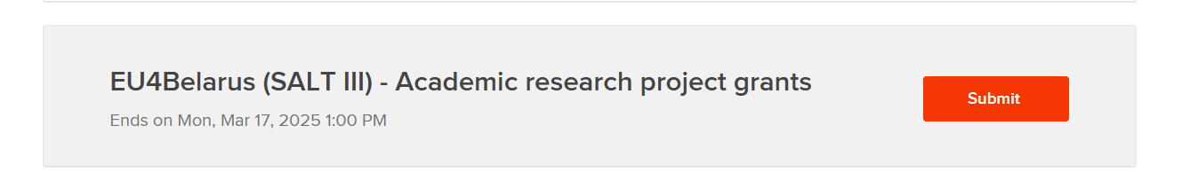
2.1. Application for research project grant (2)
Open call is announced in the CPVA website
https://cpva.lt/en/calls-for-proposals/academic-research-project-grants-in-the-framework-of-eu4belarus-support-for-advanced-learning-and-training-salt-iii-programme
Application should be prepared and submitted in online mode via link
https://centralprojectmanagementagencyyouthaccount.submittable.com/login?returnUrl=%2Fsubmit%2F312344%2Feu4belarus-salt-iii-academic-research-project-grants
eu4belarus.info

Slide 31
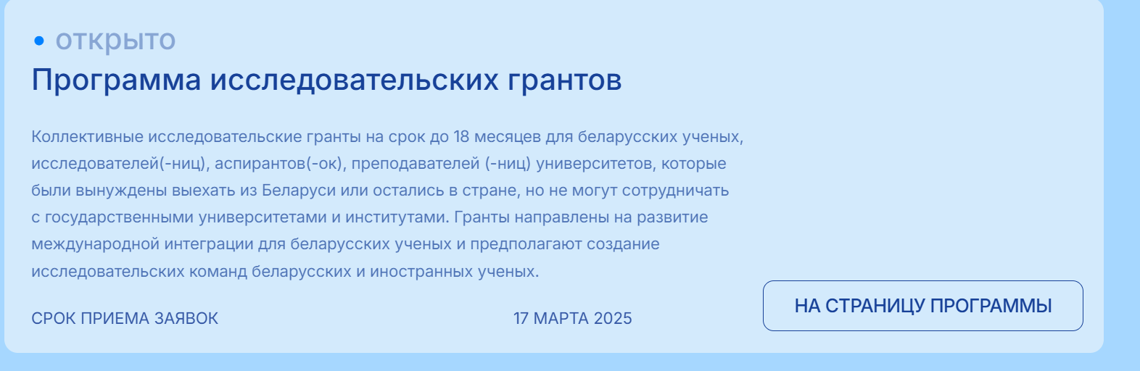
2.1. Application for research project grant (3)
Open call is announced also in the EU4Belarus website
https://eu4belarus.info/group-academic-grants-ru/
eu4belarus.info

Slide 32
2.2. Budget
eu4belarus.info

Slide 33
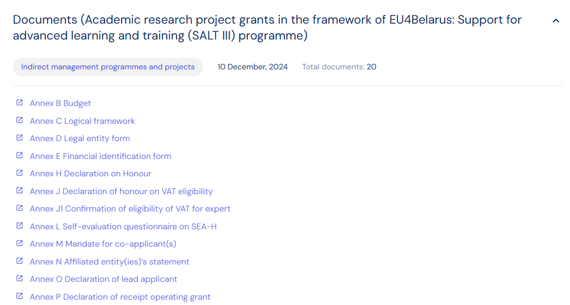
2.2. Budget
Budget form (Annex B) should be enclosed to the application as an annex.
The budget form should be downloaded from the CPVA website via link https://cpva.lt/en/documents?_sfm_programa=22663&_sfm_kvietimas=27644
eu4belarus.info

Slide 34
2.3. Logical Framework
eu4belarus.info

Slide 35
2.2. Logical Framework
Logical Framework form (Annex C) should be enclosed to the application as an annex.
The Logical Framework form should be downloaded from the CPVA website via link https://cpva.lt/en/documents?_sfm_programa=22663&_sfm_kvietimas=27644
eu4belarus.info

Slide 36
2.4. Supporting documents
eu4belarus.info

Slide 37
2.3. Supporting Documents
Other supporting documents’ form (Annexes D-P) should be enclosed to the application as the annexes.
The forms should be downloaded from the CPVA website via link also in the guidelines for applicants pages 15-17. https://cpva.lt/en/documents?_sfm_programa=22663&_sfm_kvietimas=27644
eu4belarus.info

Slide 38
III. Evaluation process
eu4belarus.info

Slide 39
3.1. Evaluation Steps
STEP 1.
Opening and administrative checks and concept note evaluation.
STEP 2.
Evaluation of full applications.
STEP 3.
Verification of eligibility of the applicants and affiliated entity (ies)
Approval
or
rejection
of the application
Deadline for submission 17th March 2025 at 13:00 EET/UTC + 2 (Vilnius time)
eu4belarus.info

Slide 40
3.1. Evaluation: Step 1 (1)
STEP 1: Opening and administrative checks and concept note evaluation.
If the deadline has been met. Otherwise, the application will be automatically rejected.
If the application satisfies all the criteria specified in the checklist in Section 1 of Part B of the grant application form. This includes also an assessment of the eligibility of the action. If any of the requested information is missing or is incorrect, the application may be rejected on that sole basis and the application will not be evaluated further.
The concept notes that pass this check will be evaluated on the relevance and design of the proposed action. The concept notes will receive an overall score out of 50. Only the concept notes with a score of at least 30 will be considered for pre-selection.
Each subsection of the evaluation grid will be given a score between 0 and 5: 0 = not provided; 1 = very poor; 2 = poor; 3 = adequate; 4 = good; 5 = very good.
eu4belarus.info

Slide 41
3.1. Evaluation: Step 1 (2)
1. Relevance of the action | Sub-score | Max 20 score | Comments
1.1 How relevant is the action to the global objective and specific objective of the call for proposals stated in the guidelines for applicants? | 5x2**
1.2 How clear and based is the problem addressed in the action and has it the potential to contribute to solving this problem? The extent to which the idea of the action is in line with the problem and situation analysis described. The extent the objectives of the action correspond to the identified and formulated problem. | 5
1.3 What new the action will bring to the relevant field of science and research? Is the proposed action can advance in solving the problem formulated in the proposal and bring valuable results? What added value it will create (e.g., innovation, new methods, approaches, best practice, practical value, social, economic or other benefit, etc.). | 5
Total sub-score (1)
eu4belarus.info

Slide 42
3.1. Evaluation: Step 1 (3)
2. Design of the research | Sub-score | Max 30 score | Comments
2.1 How coherent is the overall design of the action? Does the action indicate the expected results? Is the methodology of the research clear and relevant in achieving the expected results? Do the objectives, activities and methods chosen are well connected to achieve the expected results? Does the action include appropriate activities for dissemination of research results? | 5x2**
2.2 Does the research team proposed has the capacity to implement the action? | 5
2.3 Does the proposal include valid risk analysis and mitigation? | 5
2.4 Are the activities feasible and consistent in relation to the expected results (including timeframe)? Are results (output, outcome and impact) realistic? | 5
2.5 To which extent does the proposal integrate relevant cross-cutting elements such as human rights, gender equality, democracy, good governance support to youth, environmental sustainability? | 5
Total sub-score (2)
TOTAL SCORE (1)+(2) |  | max 50
eu4belarus.info

Slide 43
3.1. Evaluation: Step 2 (1)
STEP 2: Evaluation of full applications.
The selection criteria help to evaluate the applicant(s)'s and affiliated entity(ies)'s operational capacity and the lead applicant's financial capacity and are used to verify that they:
have stable and sufficient sources of finance to maintain their activity throughout the proposed action and, where appropriate, to participate in its funding (this only applies to lead applicants);
have the management capacity, professional competencies and qualifications required to successfully complete the proposed action. This applies to applicants and any affiliated entity(ies).
The award criteria help to evaluate the quality of the applications in relation to the objectives and priorities set forth in the guidelines, and to award grants to projects which maximise the overall effectiveness of the call for proposals.
The maximum overall score is 100. Each subsection of the evaluation grid will be given a score between 0 and 5: 0 = not provided; 1 = very poor; 2 = poor; 3 = adequate; 4 = good; 5 = very good.
eu4belarus.info

Slide 44
3.1. Evaluation: Step 2 (2)
Section | Maximum Score | Comments
1. Financial and operational capacity of the applicant and capacity of the research team | 25
1.1 Do the applicants and, if applicable, their affiliated entity(ies) have sufficient in-house experience of technical expertise, management capacity (including project management, staff, equipment and ability to handle the budget for the action)? | 5
1.2 Does the lead applicant have stable and sufficient sources of finance? | 5
1.3 Does the proposed research team leader has sufficient experience of research project management? | 5
1.4 Do the research team members, including the team leader, have sufficient knowledge and experience in the research topic? | 10
2. Relevance | 20
Score transferred from the Concept Note evaluation
eu4belarus.info

Slide 45
3.1. Evaluation: Step 2 (3)
Section | Maximum Score | Comments
3. Design of the action and implementation approach | 30
3.1 Does the action reflect a robust analysis of the problems involved: summarizes or discusses relevant prior research, identifies unresolved or new issues that the current research will address? | 5
3.2 How coherent is the design of the action ? Does the proposal indicate the results to be obtained in the research? Does it describe the collection of data, analyses, methods, experiments, and overall research process? Are the research activities proposed appropriate, practical, and consistent? Is the overall proposal coherent and provides rationale to achieve the expected results? | 5
3.3. Does the proposed research project generate innovations being it a product, process or service innovation? Does the method and techniques used in the study correspond to the current level of development of the relevant field of science? | 5
3.4 Does the research project contribute to the development and transfer of new knowledge about the research topic? Will it contribute to the development of the relevant scientific field? | 5
3.5 Does the proposal and Logical Framework include credible baseline, targets and sources of verification of the research results? If not, is a baseline study foreseen? | 5
3.6 Is the action plan for implementing the action clear and feasible? Is the timeline realistic? | 5
eu4belarus.info

Slide 46
3.1. Evaluation: Step 2 (4)
Section | Maximum Score | Comments
4. Sustainability of the action | 10
4.1 Are the expected results of the proposed action sustainable and will continue to create value after the project ends? Will they be made relevant after completion of the action to be replicated, adapted, or expanded to reach more beneficiaries, locations, or sectors, while maintaining quality and effectiveness? | 5
4.2 Does the application include relevant risk analysis and mitigation plan? | 5
5. Budget and cost-effectiveness of the action | 15
5.1 Are the activities appropriately reflected in the budget? | 5
5.2 Is the project cost-effective and will achieve the expected results while following sound financial management principles? Are all budgeted costs eligible as per article 2.1.5 of these guidelines; is clarification and justification sufficient to support the need for costs and understand cost composition? | 10
Maximum total score (1)+(2)+(3) | 100
eu4belarus.info

Slide 47
3.1. Evaluation: Step 2 (5)
If two or more applications get the same score and are at the bottom and below of the available budget for this Call of Proposals line, the Contracting Authority may take a decision to apply additional priority criteria. If both or more applications would be equal in the light of the first criterion, the next criteria will be applied:
Criterion 1: having a bigger number of politically vulnerable Belarusian persons engaged into the research team.
Criterion 2: focusing to Belarus as a topic of the research.
Criterion 3: having earlier application submission date.
eu4belarus.info

Slide 48
3.1. Evaluation: Step 3 (1)
STEP 3: Verification of eligibility of the applicants and affiliated entity (ies)
The eligibility verification will be performed only for the applications that have been provisionally selected according to their score and within the available budget for this call for proposals. It will be carried out on the basis of the supporting documents.
The declaration by the lead applicant (Section 5 of Part B of the grant application form) will be cross-checked with the supporting documents provided by the lead applicant. Any missing supporting document or any incoherence between the declaration by the lead applicant and the supporting documents may lead to the rejection of the application on that sole basis.
The eligibility of applicants and the affiliated entity(ies) will be verified according to the criteria set out in Section 2.1.
Any rejected application will be replaced by the next best placed application on the reserve list that falls within the available budget for this call for proposals.
eu4belarus.info

Slide 49
IV. Timeline of the call for proposals
eu4belarus.info

Slide 50
4.1. Timeline
 | DATE | TIME
Deadline for requesting any clarifications from the contracting authority | 24th February 2025 | 22 days before submission deadline
Last date on which clarifications are issued by the contracting authority | 7th March 2025 | 11 days before the submission deadline
Deadline for submission of applications | 17th March 2025 | 13:00 EET//UTC+2
Information to lead applicants on opening, administrative checks and concept note evaluation (Step 1) | 7th April 2025 | -
Information to lead applicants on the evaluation of the full applications (Step 2) | 12th May 2025 | -
Notification of award (after the eligibility check) (Step 3) | 16th June 2025 | -
Contract signature | 21st July 2025 | -
eu4belarus.info

Slide 51
V. Questions and answers
eu4belarus.info

Slide 52
5.1. Questions and answers
The Question & Answers online form is available at the call for proposal announcement in the CPVA webpage
https://cpva.lt/en/calls-for-proposals/academic-research-project-grants-in-the-framework-of-eu4belarus-support-for-advanced-learning-and-training-salt-iii-programme
The answers will be published at the same link.
The questions will be open 22 days before the deadline of the call for proposals (24th February 2025).
The answers will be published 11 days before the deadline of the call for proposals (7th March 2025).
eu4belarus.info

Slide 53
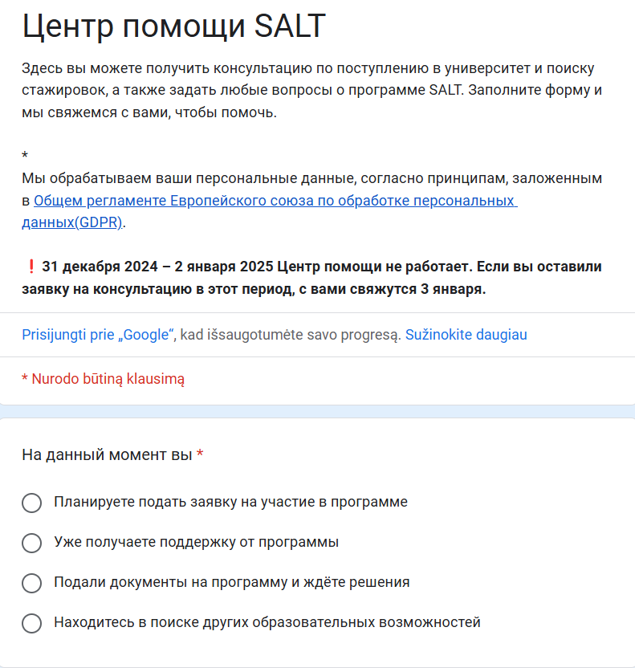
5.1. Questions and answers
The Question & Answers online form is available at the call for proposal announcement in the EU4Belarus webpage
https://docs.google.com/forms/d/e/1FAIpQLSep4GEy1LqCQiGQlunjNddiwPDdVDrh4lVESjGeSGObh9R89A/viewform
eu4belarus.info

Slide 54
Thank you!
eu4belarus.info

