Slide 1


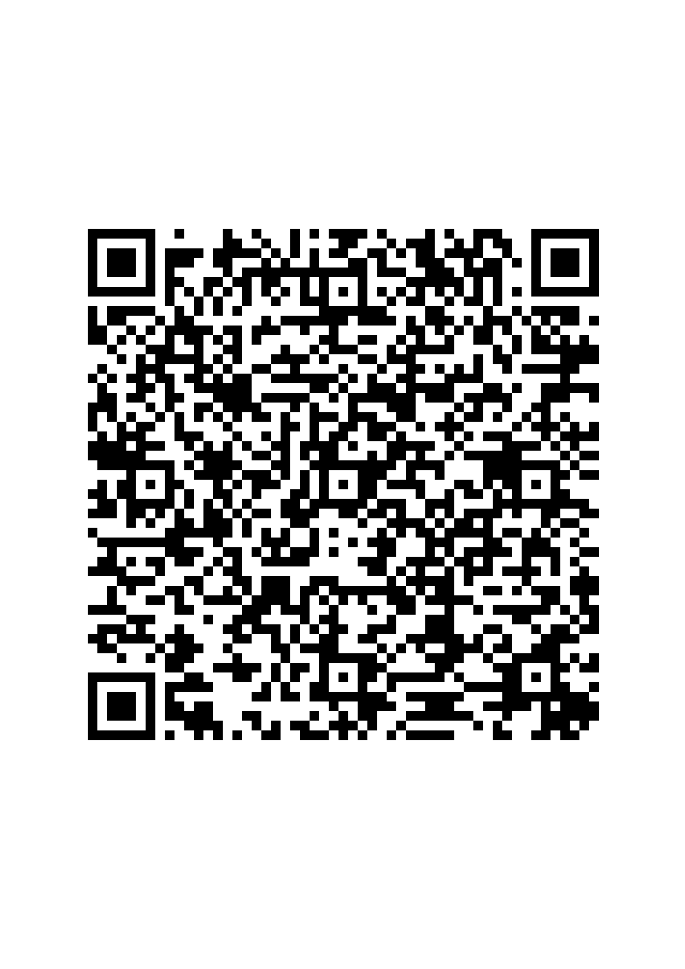



Nourishing Futures Together
EUCaN Call for Proposals
🌱
Social Protection and Nutrition for Sustainable Agri-Food Systems in the Caribbean

Slide 2




Food Security Programme
(2023-2027)
Strengthening nutritious and sustainable value chains in the Caribbean through Alliances
Investing in sustainable Food systems in the Carribean region
Increase the social inclusion of all actors in the food system
while enhancing equitable access to nutritionally adequate diets
EUCaN: Nourishing Futures Together
strengthening the regulatory framework in sanitary and phytosanitary measures, the capacity building in SPS compliance and the strengthening the fisheries sector in SPS controls
EUCaN call for proposals

Slide 3

Where and Why We're Making a Difference
The global objective of this call for proposals is to engage selected eligible applicants in contributing to the overall EUCaN goal:
Increase the social inclusion of all actors in the food system while enhancing equitable access to nutritionally adequate diets.
Antigua & Barbuda
Dominica
Grenada
Saint Kitts & Nevis
Saint Lucia
Saint Vincent & the Grenadines

Slide 4

Priority Areas
Social Protection
Strengthen schemes for smallholders, fishers, and agri-food MSMEs
Circular Economy & Innovation
Nutrition Access
Equitable access to healthy diets and behavior change
Social innovation turning waste into value,
creating green jobs
Total budget of the call
€ 500,000
Lot 1
Lot 2
Priorities 1 & 2, €50,000 – €100,000
Priority 3, €50,000 – €150,000
Funding Available
100% financing of eligible costs. No co-financing required.

Slide 5

Key Eligibility Requirements
1
For lead applicant and/or co-applicant(s)
2
For action
Established non-profit organization with legal personality
Active in sustainable agriculture, food systems, or nutrition

Slide 6
Eligibility Checklist - Who Can Apply?
Lead Applicant Requirements
Must be a legal person with established legal personality
Non-profit organization (NGO or community-based entity) /Other legal entities which are not central government ministries, municipal authorities, or formal
bodies under ministries (i.e. institutions performing direct governmental functions) may also be considered eligible. This includes foundations, trusts, public-interest
bodies, public education institutions, regional inter-governmental organisations, or other statutory bodies with a mandate linked to development and social action,
provided that they operate on a non-profit basis.
Proven experience + be active In the field of sustainable agriculture, food systems, or nutrition
Directly responsible for the preparation and management of the action with the co-applicant(s), not acting as an intermediary
Effectively established in target Caribbean countries
1
Co-applicants – same eligibility criteria
Associates - play a real role in the action but may not receive funding from the grant, with the exception of per diem or travel costs.
Target Countries
4
2
Antigua & Barbuda
Dominica
Grenada
Saint Kitts & Nevis
Saint Lucia
Saint Vincent & the Grenadines

Slide 7
Eligibility Checklist - Who Can Apply?
Application Pathways
3
Local Entity: Can apply individually if established in target countries
International Entity: Must apply in consortium with at least 2 local co-applicants
Number of applications and grants per applicants
The lead applicant may not submit more than two applications and may not be awarded more than one grant under this call for proposals per lot.
A co-applicant may not be the co-applicant in more than 1 application under this call for proposals per lot. A co-applicant may not be awarded more than 1 grant under this call for proposals per lot.
Caribbean
Caribbean
Caribbean
Non Caribbean
1
Local Caribbean Entity
Local Caribbean Entity(-ies)
International Entity Local branch(-es)
International Entity Headquarters
4
Caribbean
Caribbean
Caribbean
Non Caribbean
Local Caribbean Entity
Local Caribbean Entity(-ies)
International Entity Local branch(-es)
International Entity Headquarters
2
Caribbean
Caribbean
Non Caribbean
Local Caribbean Entity(-ies)
International Entity Local branch(-es)
International Entity Headquarters
3

Slide 8

!
Exclusions
Entities that are currently receiving direct EU funding from the European Commission or from the European Union Delegation to Barbados (or from any other EU Delegation) under the EU-Caribbean Regional Food Security Programme are not eligible to apply under this call for proposals.
However, organisations that receive funding indirectly through these direct beneficiaries remain eligible.
4
Not being in any of the situations listed in Section 2.4. of the PRAG (not included in the EU sanctions map, not be in violation of laws, ethical standards, etc)
5

Slide 9
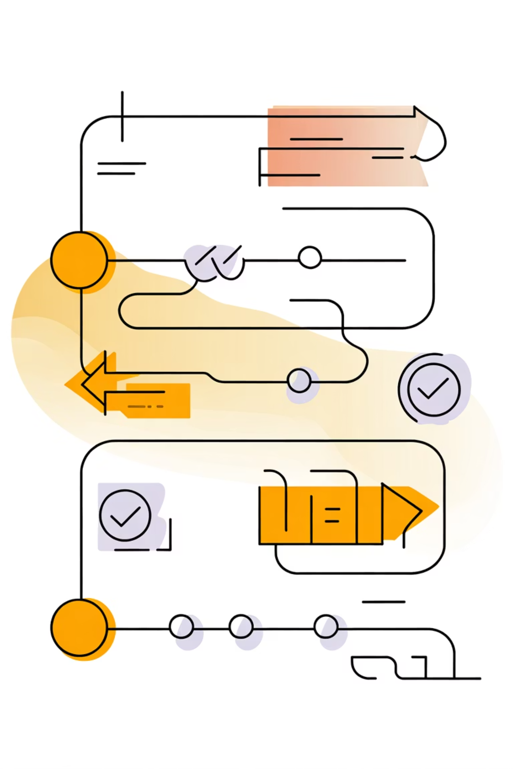
Eligibility Checklist – What actions could be funded?
General Principles
• Directly contribute to the global objective of this call for proposals.
• Address at least one of the thematic priorities set out in section 1.2.
• Be designed and implemented engaging final beneficiaries
• Ensure sustainability of results beyond the EU funding period, with strategies for continuation
or scaling-up.
• Integrate cross-cutting issues listed above as much as possible.
1
Duration
Short, high-impact actions designed for quick implementation
The project implementation period shall be indicated in whole
months only (e.g., “6 months”); mixed formats
(e.g., “4 months and 15 days”) are not accepted.
1
Minimum
6 months
2
2
Maximum
12 months
Amount
3
LOT 1 - Priorities 1 & 2, €50,000 – €100,000
LOT 2 - Priority 3, €50,000 – €150,000
Target Countries
4
Antigua & Barbuda
Grenada
Saint Lucia
Dominica
Saint Kitts & Nevis
Saint Vincent & the Grenadines

Slide 10
Target groups and Final Beneficiaries
Target groups - those directly engaged in and directly benefiting from the activities during the action.
Final beneficiaries - those ultimately indirectly benefiting in the medium to long term after the completion of the action
5
Examples of Target Groups
Small-scale primary producers in the food system
Agri-food micro-, small, and medium-sized enterprises
Vulnerable and marginalised populations
Women and youth in the food system
Institutions and organisations contributing to social protection and nutrition
Stakeholders in social innovation and circular-economy solutions
Etc.
Examples of Final Beneficiaries:
Broader communities whose food security, nutrition, and livelihoods are improved .
School, children and their families benefiting from improved access to healthy and nutritionally adequate diets.
Consumers at large gaining access to more sustainable, affordable, and locally produced food;
Future generations benefiting from environmentally sustainable and climate-resilient food systems.
Local economies benefiting from increased participation of women, youth, and marginalised groups in agri-food value chains.
Etc.

Slide 11

6
Types of action
Examples of LOT 1 actions
Promoting farmers, fisher-folk, and agro-processors to join cooperatives or producer organisations.
Strengthening cooperatives and producer organisations through capacity-building and/or equipment provision.
Capacity-building targeting farmers, fisher-folk, and agro-processors, with a focus on women and youth.
Establishing farmer field schools, peer-to-peer learning, and knowledge exchange platforms.
Supporting farm-to-school and community feeding programmes using local products.
Training on value addition, food safety, and nutrition-sensitive agriculture linking production and dietary diversity.
Awareness campaigns on healthy diets, local production, and climate-smart agriculture
Etc.
Examples of LOT 2 actions
Piloting circular-economy or waste-management solutions in agri-food chains.
Developing food-waste recovery and redistribution systems for schools, hospitals, or vulnerable groups.
Introducing composting or bio-digester systems for organic agricultural waste.
Piloting upcycling initiatives that turn by-products into new products (animal feed, fertiliser, cosmetics).
Creating community hubs for circular innovation engaging producers, processors, and youth
Supporting social enterprises led by women and youth focused on recycling, repair, and reuse in agri-food chains.
Etc.
!
The following types of action are ineligible:
actions of a purely commercial nature without clear social inclusion or nutrition outcomes;
actions not aligned with the global objective and priorities of this call;
actions focusing exclusively on infrastructure without accompanying capacity building or service delivery components;
actions concerned only or mainly with individual sponsorships for participation in workshops, seminars, conferences and congresses;
actions concerned only or mainly with individual scholarships for studies or training courses;
actions and measures that may result in violation of human rights in partner countries or causing significant adverse effects on the environment or the climate;

Slide 12
Activities (tasks)
Logical Framework
Overall objective
Outputs (Deliverables)
Specific Objective(s) (outcomes)
LOGICAL FRAMEWORK
 |  | Indicator | Baseline | Target | Source of data
Overall Objective (IMPACT) | Improvement of consumption of healthy food among children (6 months–15 y) in Country X | % of children receiving 3 healthy meals a day in X country | 25% (2025) | 30% (2027) | Annual household nutrition report (UNICEF, CARICOM, etc.)
Specific objective(s) (OUTCOME(s)) | Children adopt healthier food choices and practices | % of people reporting enhanced healthy eating practices | 0% (2026) | 80% (2027) | Survey conducted by project
OUTPUT 1 related to Outcome 1 | Community nutrition sessions delivered | # participants completing ≥3 sessions each. | 0 | 50 | Participant lists/facilitator reports.
OUTPUT 2 related to Outcome 1 | Awareness-raising events on healthy eating conducted | # of awareness raising events organised | 0 | 3 | Participant lists, reports.
Notes:
You can look at the logical framework from different perspectives.
Approaches could be:
Top-down approach:
Overall objective / Impact - We start with the big, long-term change we want to contribute to.
Specific objective / Outcome - We narrow this big goal into a concrete change our project can realistically achieve.
Outputs - We define what we must deliver so that this outcome can happen (concentrating on the activities).
OR
Bottom-up approach:
If we do the activities, we produce the outputs (sessions and events).
If we have these outputs, we can reach the outcome (children can change their behaviour).
If this change in behaviour happens on a large scale, it contributes to the long-term goal of better healthy food consumption (impact).

Slide 13

Financial aspects

Slide 14
Available Budget, Lot Structure,
Grant Size & Funding Rate
Total indicative budget: EUR 500,000
Lot 1 : EUR 200,00 (Priorities 1 & 2)
-Proposal total budgets in range EUR 50,000 – 100,000 (be advised – not USD or local currency)
Lot 2: EUR 300,000 (Priority 3)
-Proposal total budgets in range EUR 50,000 – 150,000 (be advised – not USD or local currency)
EU financing: 100% of total eligible costs, so no co-financing (own funds) required, however,
project does not cover VAT (or similar indirect taxes), so such taxes to be covered by your own funds
  Contracting Authority may reallocate funds between lot budgets
  (e.g. 290 000 and 310 000) to optimally accommodate the list of best proposals

Slide 15
Budget Principles
Budget must be realistic, cost‑effective, and aligned with activities
(check if activity, described in application, has its financial coverage in budget + check if budgeted amount is directly related to described activity)
-
  Budget = cost estimate AND ceiling
  (for total amount; partial/monthly payments may vary, as long as number of units delivered not exceeding the total amount, e.g. 12 months x 1000 € salary, so 1st month can be 900, second 1100, etc., as longs as 12 months and not exceeding 12 000 €)
-
-
  Actual costs = paid what is incurred, not what is budgeted
  (e.g. monthly salary in budget – 1000 €, actual salary based on pay slip – 900 €, contract/project covers 900 €).
  Corrections to proposal budget may be applied after award decision, during contract development stage; total budget amount remains the same, so deviations are balanced with other budget items
  (arithmetical errors, ineligible costs, consolidation or separation of budget lines, etc.)
-

Slide 16
Eligibility of Costs – Key Conditions
Costs must be necessary, reasonable, justified, and incurred during the action. Must be directly linked to scope and results of the project as described in application
Costs must comply with GfA and Contract’s General Conditions (see 2.1.4 GfA, Annex II “general conditions of Grant Contract)
Must be supported by evidence (contracts, invoices, payslips)
Must be incurred (in the amount it was paid)

Slide 17
Eligible Direct Costs
Ineligible Costs
Debts/interest, provisions for losses
Project management & admin staff eligible (can be employment or service contract)
External experts / service providers eligible (can be employment or service contract)
Travel & per diem (primarily within the 6 Caribbean countries), per-diem per internal rules, not exceeding CE rates
Events: workshops, trainings, seminars
Service contracts for project and contract needs
Supporting costs: bank transfer fees, cost verification audit
Equipment & supplies (rent/purchase max 30% of total eligible costs)
Visibility costs, dissemination
Costs funded by other EU actions
Purchase of land or buildings
Currency exchange losses
VAT
Direct funding (transfers, cash rewards) to 3rd parties.
Staff costs: salaries + social charges (no bonuses)

Slide 18
!
Other important information
  Indirect costs: flat rate up to 7% of eligible direct costs; not reported or audited.
  Support to 3rd parties must be provided via activities (training, equipment, services).
  No financial guarantee required.
  Initial pre-financing up to 80% of contract value, but could be paid in parts or a single transfer depending on the properties of the project (TBD during contract development) .
  No contingency reserve.

Slide 19

  Expenditure Verification
  Mandatory expenditure verification(s) by external auditor for the single (final report), see 15.7 of general conditions.
  Applicable regardless of grant size.
  To be budgeted in the budget of the project.
  Financial questionnaire and annual financial reports
  Provide the lead applicant’s profit and loss statement and balance sheet for up to the last three closed financial years (latest accounts not required from co-applicants).
  Complete and submit the Financial Capacity Verification Questionnaire (Annex E) with all required supporting documents (registration proof, recent bank statement, list of implemented projects, etc.).
  Submit all documents as scanned/electronic copies showing clear stamps, signatures, and dates; originals must be kept on file for controls (PRAG 2.5.5).
  If documents are not in English, attach English translations of the relevant parts proving eligibility.
  (Missing documents by the application deadline may result in rejection of the application)

Slide 20
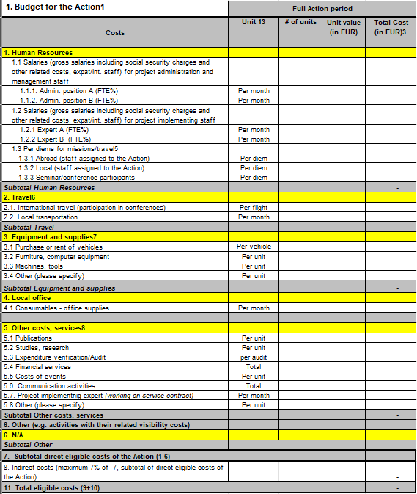

Template of the Budget
Template of the budget: Annex B Budget (Excel format)
General recommendations
Please review Instructions in the Budget tab bellow the Budget
table for directions of how to indicate requested amount for each
Budget category.
Complete the data in all tabs in Budget tab,
In Justification tab justify filled in Budget lines,
In Expected sources of funding tab indicate contribution amount
and other relevant information.

Slide 21
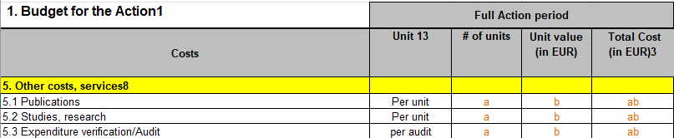
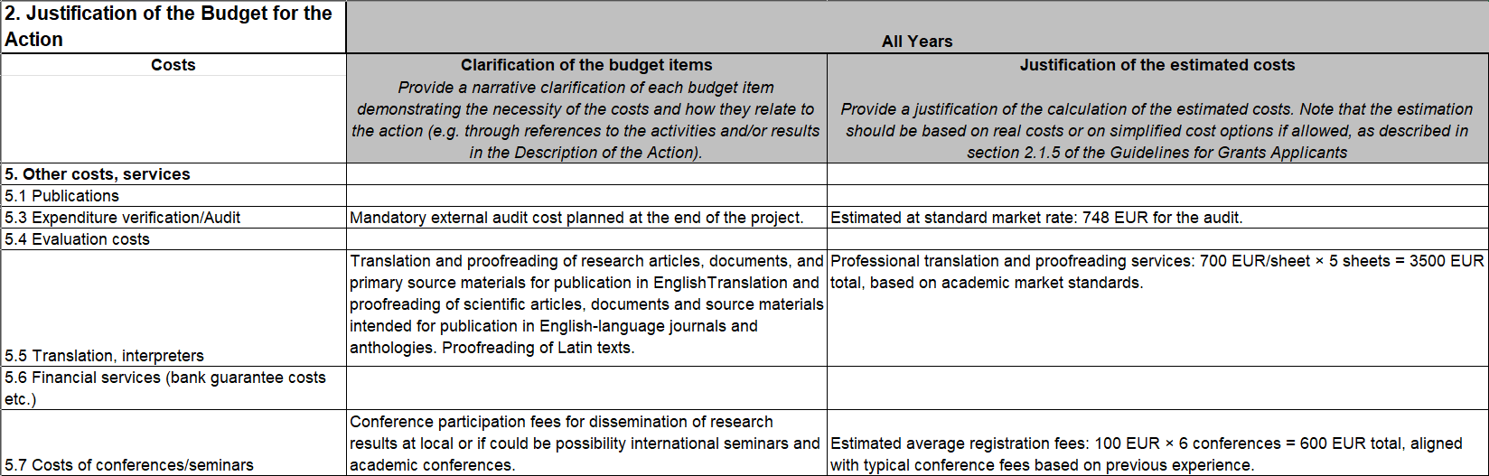
Budget completion guide: Budget
1. Indicate: Unit, number of units, unit value (EUR) and total amount of cost (EUR) in the tab Budget
2. Justify costs in the tab Justification. Provide narrative clarification and calculations for each budget line
Example

Slide 22
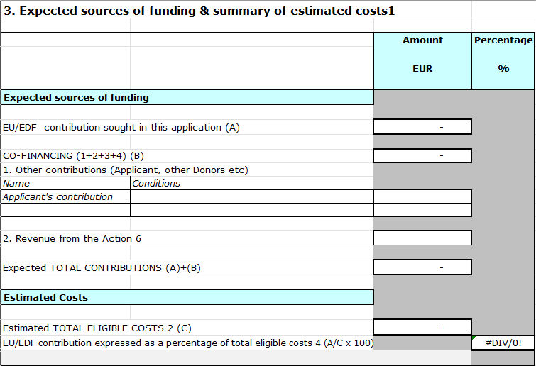
3. Indicate sources of funding in tab: 3. Expected sources of funding
100 % will be covered by the EU/EDF (No co-financing required)

Slide 23
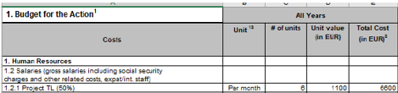
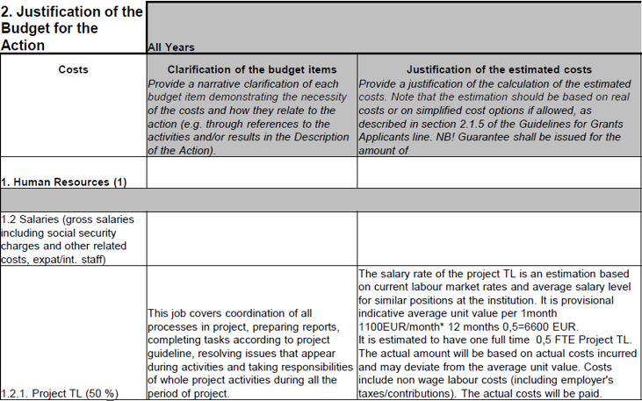
Budget heading: 1. HUMAN RESOURCES
Main principles of planning:
Costs should be foreseen for staff to be hired directly for the
implementing of activities (or service contracts concluded; in such case,
costs of services to be included in new sub-heading 5).
The rate should follow the existing salary structure within the
organization for a similar position.
JUSTIFICATION: Describe the role and responsibilities of each position,
determination of unit value.
Note! Bonuses are ineligible costs
Full time equivalent (FTE) should be used to calculate salaries:
FTE is the hours worked by one employee on a full-time basis,
typically considered 40 hours per week.
A 40-hour employee should be shown as 1.00, 30 hours as 0.75
and 20 hours as 0.50 (50%)
Budget line name should include FTE percentage (e.g. „1.2.1
Project TL (50% )”)
Enter the calculated full-time salary, percentage of time that will be
spent on the grant objectives
Example
Example

Slide 24
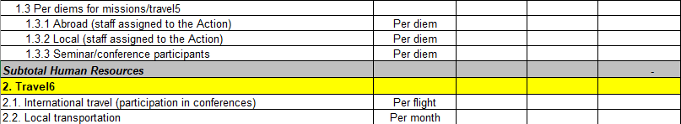
Budget heading: 2. TRAVEL COSTS and 1.3. Per diems
Please specify the cost per person of travel expenses, including transportation and per diem.
Use organisational per‑diem size, which does not exceed EC limits
Please in the Justification indicate:
Explain the need for all travel, link to activity. Indicate Destination countries, number of travellers and days in trip.
Route (countries), trips, transport type (air, ship), number of passengers and their roles/tasks; economy class.
Local travel - transport from Actions HQ (e.g. capital city) to other locations in the same country.
If included, provide reasoning (e.g. direct engagement with regional stakeholders, on-site assessments, participation in events)
https://international-partnerships.ec.europa.eu/document/download/167fc5d8-015b-4a51-85b1-266891fbcc21_
en?filename=per-diem-rates-20241108_en.pdf

Slide 25
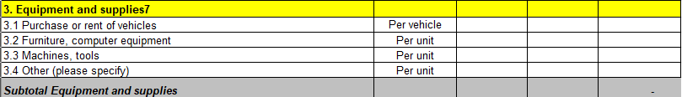
Budget heading: 3. EQUIPMENT
Long-term (fixed) assets to be used during and after the Action implementation period
Type of asset | Purchase*
 | Final owner (after of actin) | Usage after end of action | Full cost | Partial Cost**
Used to generate action results (e.g. pilot farming equipment, IT for local communities, prizes for top contestants, etc.) | Final local beneficiaries (not grant contract parties) |  | ✓
Used to administer/implement the action (e.g. laptops/IT equipment/vehicles/furniture for applicant's team members) | Transfer to Final local beneficiaries (not grant contract parties) | Justified usage for sustainability / for same goals as action / other EU funded actions | ✓
 | Kept by applicant and/or co-applicants (parties to the contract) after end of the action |  | ✓
 |  | Usage for own needs |  | ✓
* Option to rent is available in all scenarios
** Pro-rata, equal to depreciation costs for the time period of the action

Slide 26
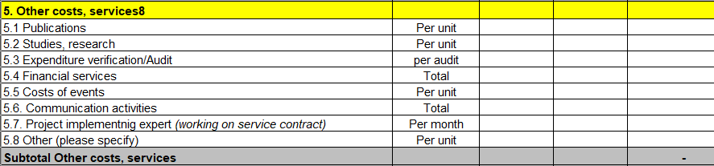
Budget heading: 5. OTHER COSTS, SERVICES
These are specific external costs necessary for project implementation that cannot be included under other budget headings.
They must be clearly justified, linked to project activities, and procured in line with Procurement rules for beneficiaries (Annex 4).
Note that all expert services for the activities under service contracts, must be indicated in line 5.7.

Slide 27
Check before submission of
the proposal
  Budget coherent with narrative and logical framework
  Ensure budget aligns clearly with activities and outputs
  All cost categories justified and eligible
  Avoid over-budgeting or weak justification for costs
  Check arithmetic consistency
  Equipment costs within 30% limit
  Indirect cost rate 7%
  Visibility costs foreseen
  Expenditure verification budgeted
  All documents uploaded (templates unchanged)

Slide 28


How to Apply
01
Review Guidelines for Applicants
Read Guidelines for Applicants thoroughly
www.cpva.lt
02
Submit application
Via system in English by January 21, 2026
03
Do not forget to include documents
Attach all required signed/filled forms

Slide 29

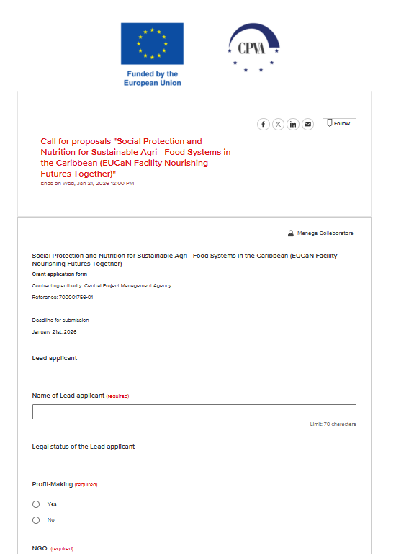


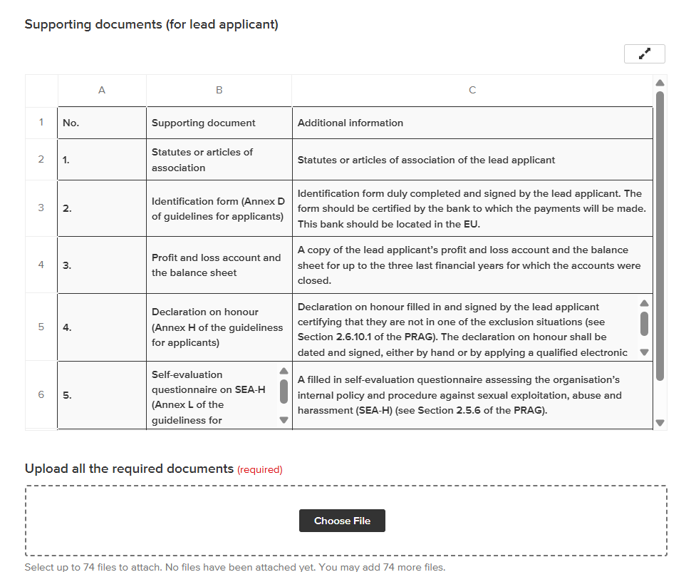
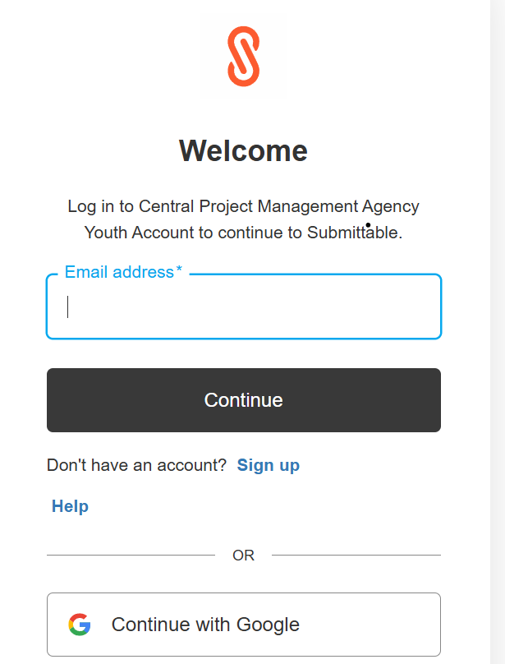
!
JANUARY 21st, 6 AM AST, 2026
Possibility to save the Draft
(but do not forget to SUBMIT!
Possibility to include collaborators

Slide 30
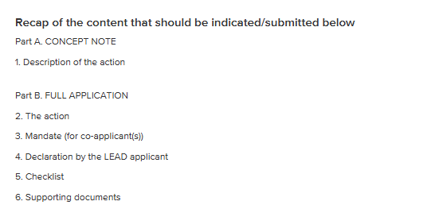
Evaluation and Selection of the Applications (1)
1st part – Administrative Check
2nd part – Concept note (PART A of the application) Evaluation
3rd part – Full application ( PART B of the application) Evaluation
Notification by email
Notification by email
2 and 3 parts of application will evaluated be by the external assessors. Seeking transparency and quality results, one application will be evaluated by at least 2 different assessors.

Slide 31
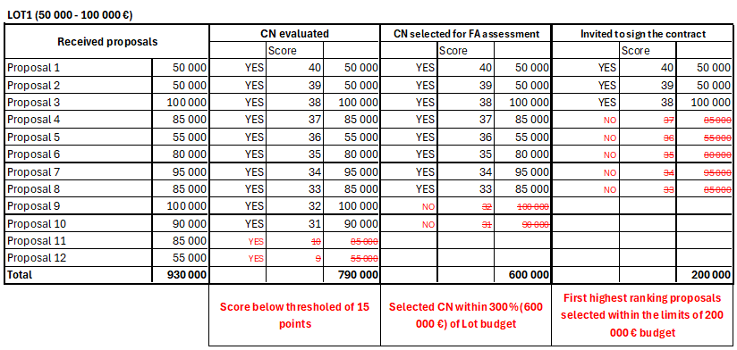
Proposal selection process in light of available funding

Slide 32
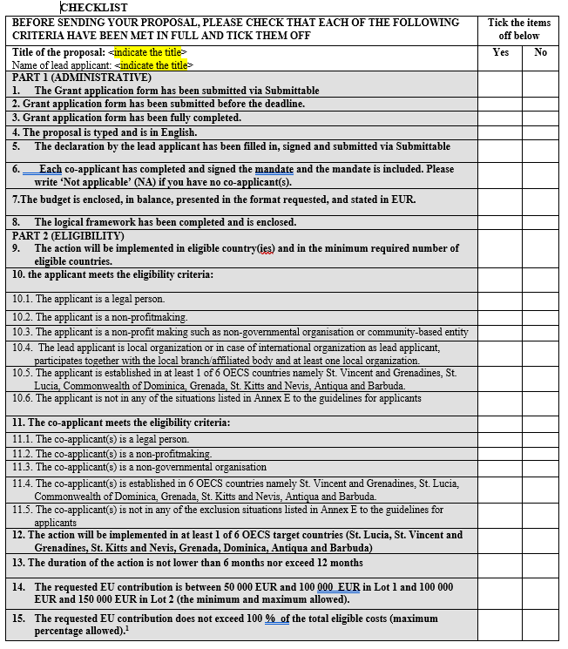

Evaluation and Selection of
the Applications (2)

Slide 33
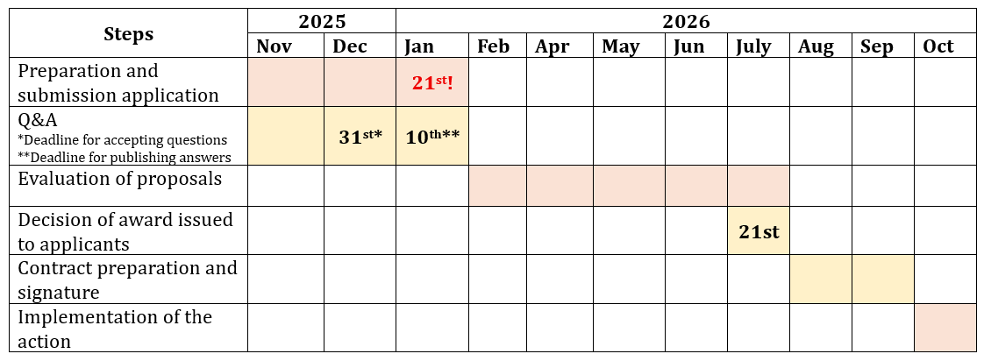
Critical Deadlines
!
Notification by email
Notification by email

Slide 34





Ready to Make a Difference?
Read Guidelines
Ask Questions
Submit by December 31, 2025
Submit Application
Deadline: January 21, 2026
Any Issues
e.vaitekunaite@cpva.lt
https://cpva.lt/en/calls-for-proposals/social-protection-and-nutrition-for-sustainable-agri-food-systems-in-the-caribbean-eucan-facility-nourishing-futures-together

Slide 35

EUCaN Call for Proposals
🌱
Social Protection and Nutrition for Sustainable Agri-Food Systems in the Caribbean
Your time to accept it!
🌱
Project Manager
Ms. Eimante Vaitekunaite
e.vaitekunaite@cpva.lt
Project Financial Officer
Ms. Jone Sarkuviene

